Slide 1
Team Aegle
Project Charter & Plan
Team Members:
Joseph Finnegan
Carlos Torres
Karla Hernandez
Joe Martinez
Notes:
Carlos - don’t forget to remind people what our project actually is

Slide 2
Topics
MS Project Plan
Project Charter
Notes:
Carlos

Slide 3
Outreach RFID Inventory System
Sponsor: Dr. Tiernan
Consumer: Dr. Tiernan and Associates
Problem: Inventory of Outreach system is manual and takes a lot of human effort to keep track of it.

Slide 4
General Organization
•Project Manager: Karla Hernandez
•Responsibilities:
–Guiding team
–Main point of contact with sponsor
–Schedules team meetings
Notes:
Karla, Carlos & Joe prepare in case Karla doesn’t show up, slides 8 thru 12

Slide 5
Project Oversight
•Team has agreed to have all major deliverables finished one week before due date
•Documents in progress are hosted on GitHub for version control
•Team uses group chat app to communicate informally outside of meetings
Notes:
Karla,

Slide 6
Roles & Responsibilities
•Karla Hernandez
–Team Lead
–Architecture Lead
•Joseph Finnegan
–Software Manager
–Test Lead
–Server Lead
–Risk Manager
Notes:
Karla

Slide 7
Roles & Responsibilities, cont.
•Joe Martinez
–Document Master
–Database Lead
•Carlos Torres
–Project Planner
–Hardware Lead
•Dr. Tiernan
–Project Sponsor
–Provide feedback
Notes:
Karla

Slide 8
Project Constraints
•Limited Time
–Project must be delivered in roughly 6 months
•Limited Budget
–Budget of $800
–Could constrain hardware design
•Lack of Knowledge
–Team has no experience with RFID technology
Notes:
Karla

Slide 9
MS Project Plan
Overview of the project plan
Task estimation
Updates to plan
Notes:
Carlos

Slide 10
Task Breakdown
Previous documents are analyzed.
Task are assigned according to team member’s strengths and complexity.
Team has a internal deadline of 8 days before the external deadline.
Notes:
Complexity based on previous Projects.

Slide 11
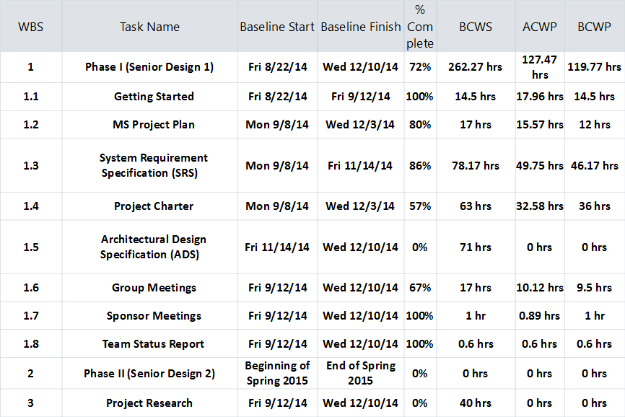
Overview of the Project Plan
Notes:
Carlos

Slide 12
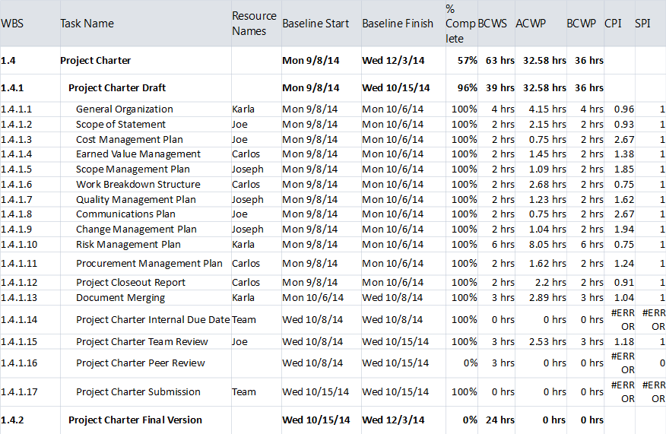
Overview of the Project Plan
Notes:
Carlos

Slide 13
Task Estimation & Breakdown
Researched previous SD projects
Ballpark estimation
Task Assigning
Notes:
Carlos

Slide 14
Updates to Plan
Weekly Meetings
Updates after any progress
Notes:
Carlos

Slide 15
Project Person-hours Budget
Approximately 6-7 months to complete project
Each person works 15 hours per week
As a 4 man team, this is 1440-1680 hours total over the life of the project
Notes:
Joe

Slide 16
Cost Breakdown
Parts | Cost
Handheld RFID Reader | $600.00
RFID Tags | $20.00
Miscellaneous Items | $30.00
Plastic Crates | $40.00
Server (6 months) | $30.00
Total Cost | $720.00
Notes:
Joe

Slide 17
Scope Management
Will meet with our sponsor every week
Discuss project status and address concerns
Notes:
Joseph

Slide 18
Change Control
Used after detailed design has already begun
Any change must be submitted with a change proposal form
Team must decide if change is important enough to be implemented
Team must revise all design, specification, and planning documents to include change
Notes:
Joseph

Slide 19
Quality Management
Documentation
Kept on GitHub for version control
Final versions stored on Google Drive
Rough drafts reviewed by document master
Software
Test driven development
Consumer inclusion
Notes:
Joseph

Slide 20
Quality Management, cont.
Hardware
Will be evaluated by the entire team
Each piece of hardware will be assigned a weighted value by team
Testing
Software will be unit tested as it is being developed
Hardware will be tested before it is integrated with software
After individual testing, both software and hardware will be integrated and tested
Notes:
Joseph

Slide 21
Communication Plan
Internal
Regular team meetings
Whats App mobile app
Email
GitHub
External
Sponsor Meetings
Email project document to sponsor
Project Supervisor
Notes:
Joe

Slide 22
Change Management
Roles & Responsibilities
Project Sponsor
Will propose/approve any significant changes
Proposal must be submitted to team with a change request form
Must meet with team to discuss proposed change
Project Manager
Primary point of contact for 3rd parties wishing to contact team
May use discretion concerning change proposals
Notes:
Joseph

Slide 23
Change Management, cont.
Project Team
Discuss and analyze proposed changes
Estimate additional effort and monetary cost needed
Team must come to unanimous decision for change
Mr. O’Dell
Will be notified of approved changes
Thoughts will be taken into consideration concerning final change approval
Notes:
Joseph

Slide 24
Change Request Form
Source of Change
Date of Change Request Submission
Description of Change
Justification of Change
Areas for sponsor and team signatures
Notes:
Joseph

Slide 25
Risk Management
Roles & Responsibilities
Project Sponsor
Risk Identification from client’s POV
Project Manager
Maintain communication with risk manager
Guiding team and avoiding critical risks
Notes:
Karla, Joseph prepares for slides 23 to 27 in case Karla doesn’t show up

Slide 26
Risk Management, cont.
Project Team
Responsible for identifying risks
Must follow steps stated in risk management plan
Risk Manager
Joseph Finnegan is designated Risk Manager
Will document and keep track of risks that emerge during development
Monitor risk mitigation process
Notes:
Karla

Slide 27
Risks Identified
Category | Risk | Probability | Cost
Technology | Choose correct RFID reader | 20% | 14
Sponsor | Tracking items in the storage room is an unrealistic requirement. | 100% | 15
Team | Lack of RFID Technology knowledge | 100% | 23
Team | Underestimation of tasks | 35% | 2
Team | Other work | 75% | 2
Team | Incorrect Project Design | 15% | 18
Total | 74
Notes:
Karla

Slide 28
Risk Severity
Choose correct RFID reader: High
Tracking item location: High
Task underestimation: Medium
Incorrect project design: High
Notes:
Karla

Slide 29
Risk Documentation
Risks will be documented by risk manager
Risk manager will create mitigation plan
All risks mitigated will continue to be monitored
Notes:
Karla

Slide 30
Procurement Management
Roles & Responsibility
Project Sponsor
Provide suggestions/advice concerning components and services needed
Project Manager
Will make final decision on which components and services will be purchased
Notes:
Joe

Slide 31
Procurement Management, cont.
Project Team
Will provide project manager with their opinions concerning components/services needed
Responsible for researching components and services needed
Mr. O’Dell
Will make final decision as to which components and services are purchased
Notes:
Joe

Slide 32
Procurement & Timing
Components and services needed will be procured at least 2 weeks in advance
To ensure that all components and services are ready before implementation
Notes:
Joe

Slide 33
Description of Items/Services
RFID Reader
RFID tags
Antennas
Cables to connect Antenna to reader
Ethernet cable
Host computer

